Slide 1
AV Blocks Ventricular blocks heart blocks AV nodal blocks PR elongations
Type 1, Type 2a. Type 2. Type 3
AKA:
1st Degree
2nd Degree (type1) Mobitz 1; AKA Winkiebach 2nd Degree (type2) Mobitz 1a (IIa)
3rd Degree AKA Complete Block or Total Heart Block

Slide 2
“Replace excuses with EFFORT
Replace laziness with DETERMINATION
and
everything else will fall into PLACE!”

Slide 3
1st degree
Has underlaying rhythm
Regular (most of times)
Rate – that of underlying rhythm.
PR I >.20 seconds
QRS – Normal
Charted as NSR with 1st degree block

Slide 4
2nd degree av block Mobitz I Winkiebach
“Normal, Long, Longer, Drop, Now you have Winkibach!
Ventricular rate often Irregular, Atrial Rate – reg.
QRS Normal
PR I – Increasing until the drop.
No underlying rhythm

Slide 5
2nd Degree Mobitz II
Ventricular Rate – Irregular
Atrial Rate – Regular
P Waves Present – Punctual and similar
PR I – Normal or Prolonged
QRS – Mostly Abnormal
No underlying rhythm.

Slide 6
3rd Degree Block Complete Heart Block
Atria and Ventricle DEPOLAROZOMG separately
PR Undeterminable
QRS – Can be wide
P- waves can be present, buried, or after complex
Most dangerous block

Slide 7
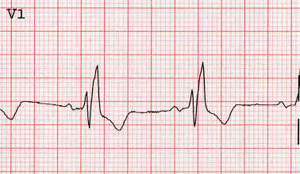
Right Bundle Branch Block
Seen on L I, V1, V6
V1 gives us a RsR
T wave abnormality
P waves –normal
Rate/Rhythm – normal
QRS- Prolonged >.10
Bizarre
Increased Amplitude
T Wave Abnormal

Slide 8
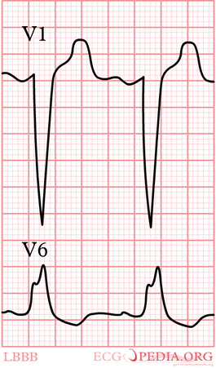
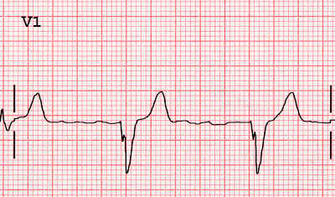
LBBB
Same as RBBB

Slide 9
LBBB/RBBB

Slide 10
ST Changes
Elevation
Depression

Slide 11
Causes
Above the line
Below the line
Active/Old Heart Attack
Injury
Ischemia
Lack of blood
Lack of O2
Deep q waves are our indicators of old MI

Slide 12
NSTEMI
STEMI

